Slide 1
BDA Project Presentation
Logistic regression on Breast Cancer data
Jonne Kurokallio
Ales Suchomel

Slide 2
Introduction
Bayesian workflow and anaysis to breast cancer dataset
Binary classification task
Multiple logistic regression models
Models differ by the used priors and chosen features
Models compared using leave-one-out cross-validation
Predictive performance was evaluated on the best model

Slide 3
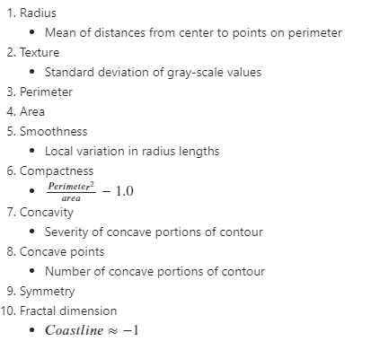
Wisconsin breast cancer data set
Total of 32 features with binary labels
569 measurements of fine needle aspiration extractions
Only 10 features (the real measurements) are used in this study

Slide 4
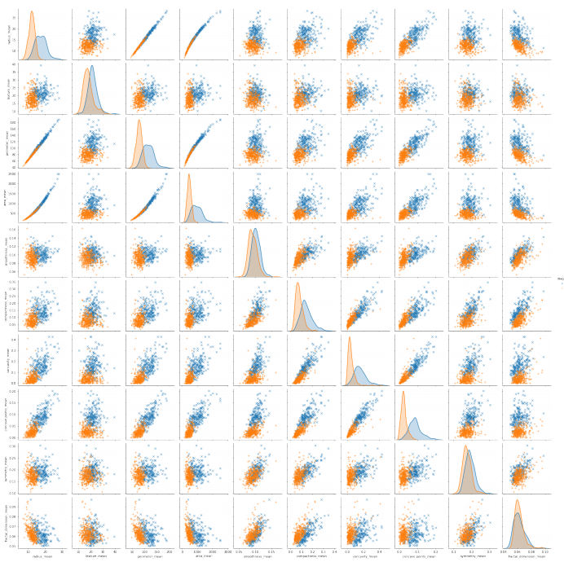
Data pairplot
Relative distributions of each feature
Some features seem highly correlated
Some features bring little to the classification

Slide 5
Preprocessing summary
Prior | Features | LOO – value?
Unconjugate normal | PCA-6
 | PCA-3
 | PCA-all
 | Custom-5
 | Original data
 | Standardized data
Student’s T | PCA-6
 | PCA-3
 | PCA-all
 | Custom-5
 | Original data
 | Standardized data
Cauchys | PCA-6
 | PCA-3
 | PCA-all
 | Custom-5
 | Original data
 | Standardized data
Features:
Principal componen analysis
Reduce the data dimensions to 3,6 and 10
Custom
Based on data plots, hand select 5 features that seem most influential
Original
The original data unchanged and standardized

Slide 6
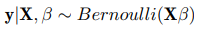
Models
Base model
Linear correlation between features and predictions
Bayesian formula
Likelihood
Priors
All weakly informative
Three different prior choices
Unconjugate normal- prior
Student’s t- prior
Cauchys- prior

Slide 7
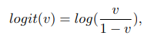
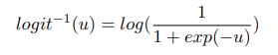
Logistic regression
One of the most popular classifier
Link function and its inverse
Modelling formulated in Pystan

Slide 8
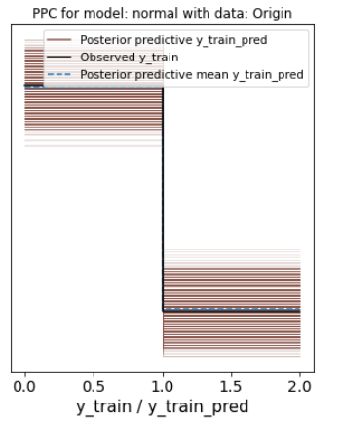
Model convergence and posterior predictive checks (PPC)
Convergence
PPC

Slide 9
Model comparison and sensitivity

Slide 10
Best model and predictive performance

Slide 11
Conclusions and future improvements

